Slide 1

Machine Learning
Artificial Intelligence
School of Computing
Universiti Teknologi Malaysia

Slide 2
Machine Learning
How do we teach a machine to learn?

Slide 3
Taxonomy
Learning types
  Supervised learning
  Unsupervised learning
  Reinforcement learning
Machine learning process
From data to features
Machine learning techniques
  Clustering, classification, regression
Evaluation metrics
Computational intelligence

Slide 4
Machine Learning
Learning Types

Slide 5
Learning types
Supervised learning
  The correct classes of the training data are known
Unsupervised learning
  The correct classes of the training data are NOT known
Reinforcement learning
  Machine learn its behavior based on feedback from environment

Slide 6
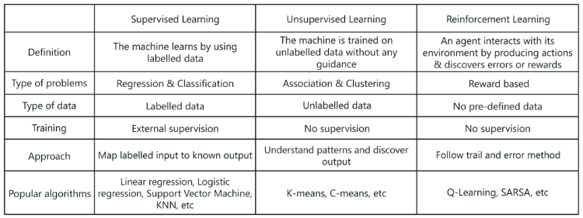
Learning types

Slide 7
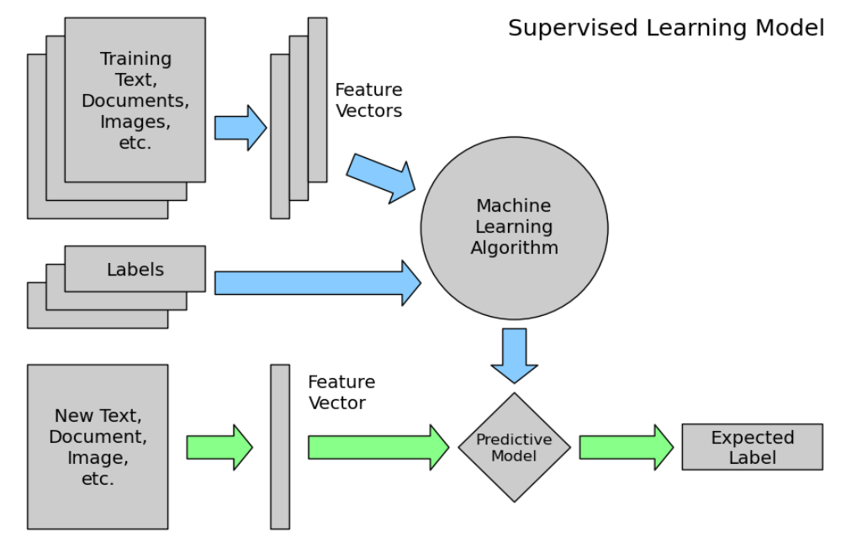
1. Supervised Learning

Slide 8
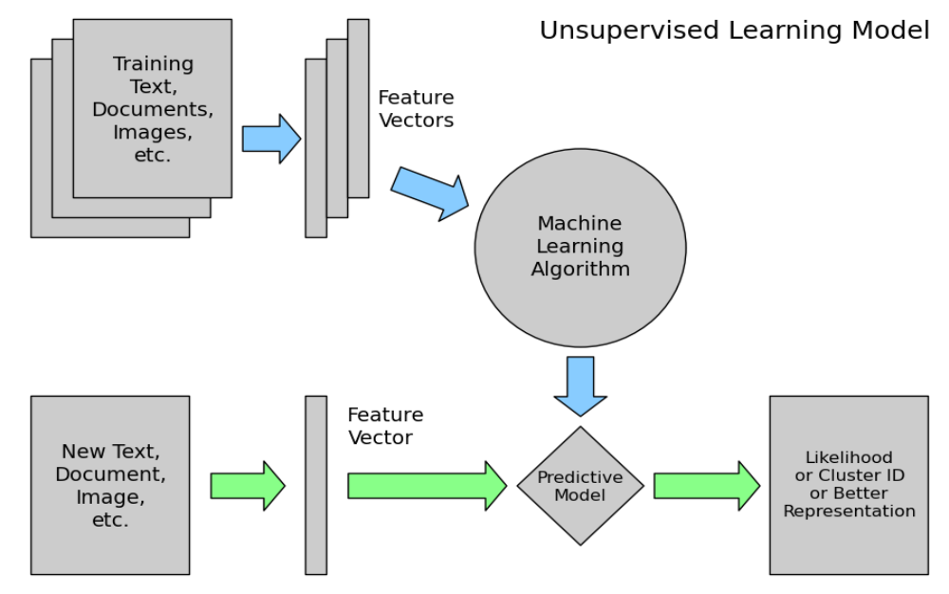
2. Unsupervised Learning

Slide 9
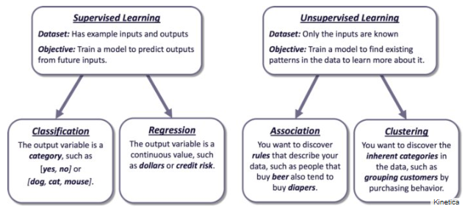
Supervised vs unsupervised

Slide 10
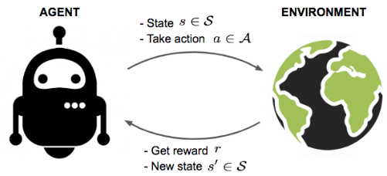
3. Reinforcement learning
An agent interacts with the environment trying to take smart actions to maximize cumulative rewards
The environment is formulated using Markov decision process to search for solutions

Slide 11
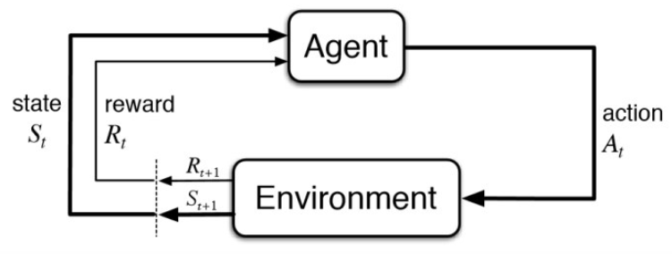
Markov Decision Process (MDP)
Feedback from the environment
Action that agent performs in environment
Current situation of the agent
Physical world in which the agent operates

Slide 12
Markov Decision Process (MDP)
The agent is acting in an environment
How the environment reacts to certain actions is defined by a model which we may or may not know
The agent can stay in one of the many states S of the environment and choose to take one of the many actions A so that it can switch from one state to another
Which state the agent will arrive is determined by transition probabilities P between states
Once an action is taken, a reward R is delivered by the environment as feedback

Slide 13
RL in real world
Games
  AlphaGo, AlphaGo Zero etc
Robotic
  (remember Spot from BostonDynamics?)
Traffic light control
Web system configuration
And many more

Slide 14
Machine Learning
Learning Process

Slide 15
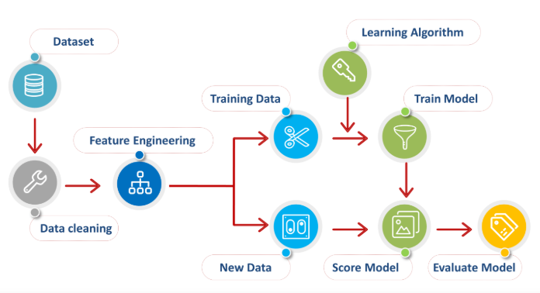
Machine Learning Process

Slide 16
How machine learns?
Machine learning utilizes techniques of understanding patterns from input data
Data is used for training by learning algorithm to learn and develop a specific computational model
Pre-processing involves extracting important features of data
Model refers to predefined prototype problem solver, produced based on patterns of input data

Slide 17
Machine Learning
From Data to Features

Slide 18
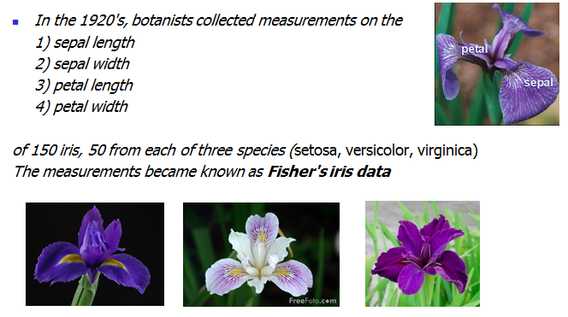
Some real data

Slide 19
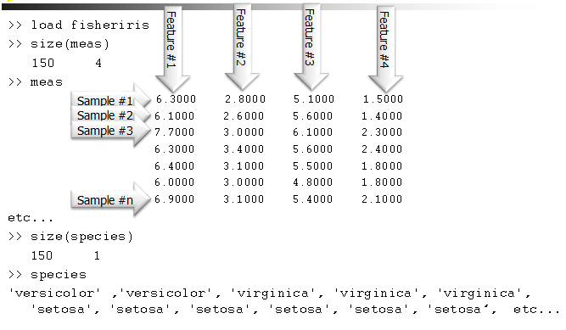
Iris data

Slide 20
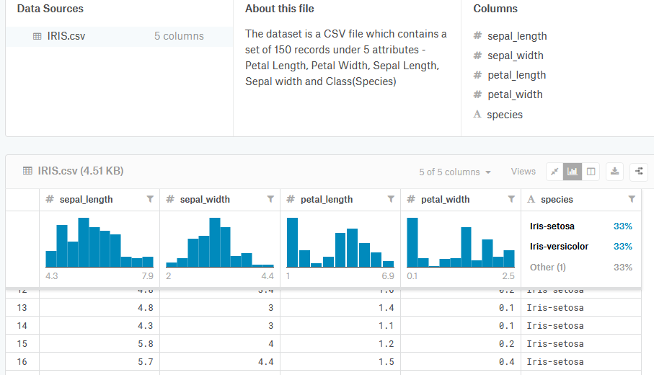
Iris data
https://www.kaggle.com/arshid/iris-flower-dataset

Slide 21
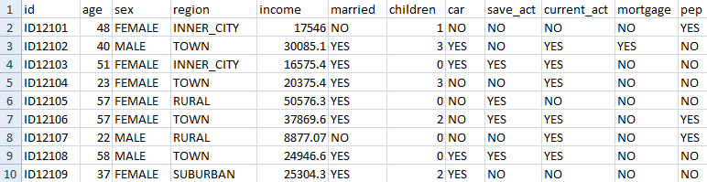
Data to Features
Collection of data observations and their attributes/features
Attribute is the properties or characteristics of the data object
Attribute is aka feature / field / characteristic / variable
Observation/instances/examples/samples/objects/records
Class

Slide 22
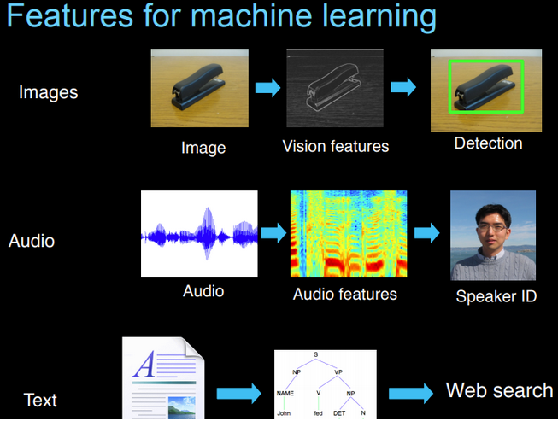
Features can be from many forms of data; images, audio or text

Slide 23
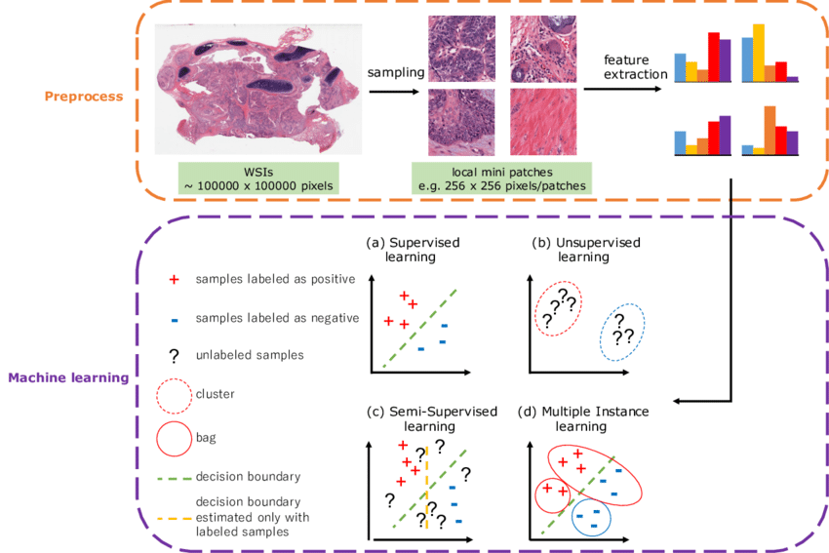
Real world example: Steps of ML in digital pathological image analysis

Slide 24
Machine Learning
Learning Techniques

Slide 25
Machine learning techniques
Classification
  Predict class from observation
Clustering
  Group observations into ‘’meaningful” groups
Regression
  Predict value from observations

Slide 26
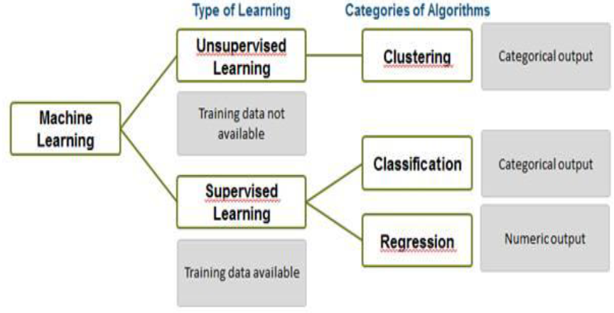
Classification and clustering

Slide 27
Classification
Classification refers to predicting the class of given observations/data points
Class means targets/labels or sometimes categories
In classification, we are mapping the input data to specific type of class/category

Slide 28
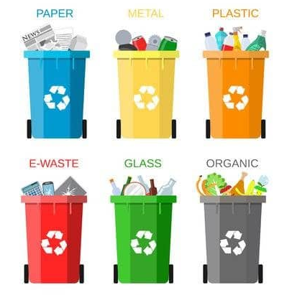
Classification
Classification of waste
You know beforehand each bin category/class of the waste
How do you decide which waste goes to which bin?
We learn from the waste i.e. from the data points, then we can decide to which class it belongs to

Slide 29
Classification
The data that gets input to the classifier may contains four measurements for waste e.g. 1)what material it is made from, 2)size, 3)weight and its 4)biodegradable level
The job of the classifier then is to output the correct waste type for every input

Slide 30
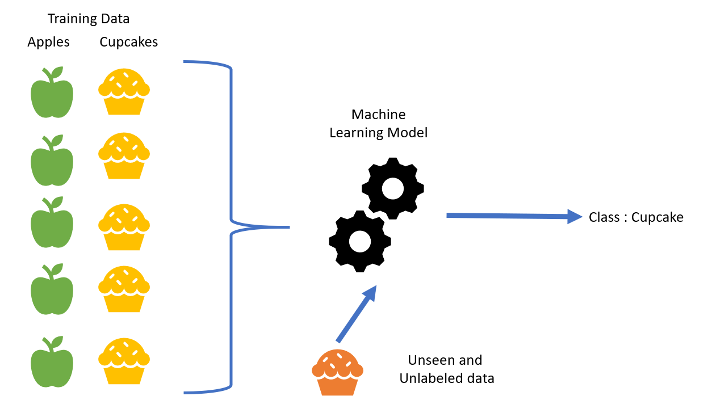
How classification works
Data set = features and class label
Data separated int training data and testing data
ML algorithm predicts the class label of the testing data

Slide 31
Classification algorithms
Decision tree
Naïve Bayes
ANN, now evolving into Deep Learning
Random Forest
K-Nearest Neighbour
Support Vector Machine (SVM)
And many more!

Slide 32
Clustering
Clustering is identifying similar groups of data in a dataset
We assume that observations in each group are comparatively more similar to observations of that group compared to those of the other groups
A cluster refers to a collection of data points aggregated together because of certain similarities
E.g. try to understand customers better so that we can market our products to them better. How do we start?
E.g. try to find your close-knit groups of friends on Facebook? How will you identify them?

Slide 33
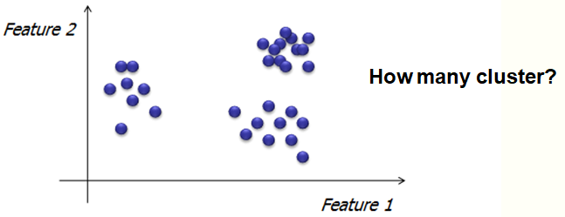
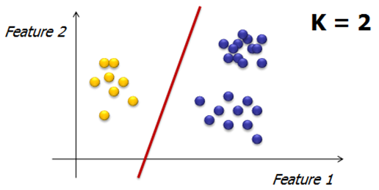
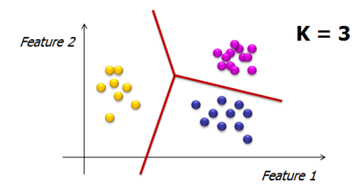
Clustering
Clustering using k-mean algorithm

Slide 34
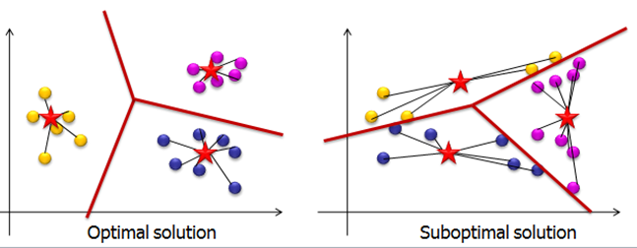
Clustering (k-mean algorithm)
Find similarities among all observations such that similar observations can be put in clusters
Computing distance from each observation/data point to centroids to obtain well-represented clusters.
Why are they optimal and suboptimal solution? Can you guess?

Slide 35
Clustering (k-mean algorithm)
Centroid == mean i.e. averaging the data
Data points are allocated to the nearest centroid/cluster as to keep the centroids as small as possible
Find similarities among all observations such that similar observations can be put in clusters
Computing distance from each observation/data point to the centroids to obtain well-represented clusters.
Why are they optimal and suboptimal solution? Can you guess?

Slide 36
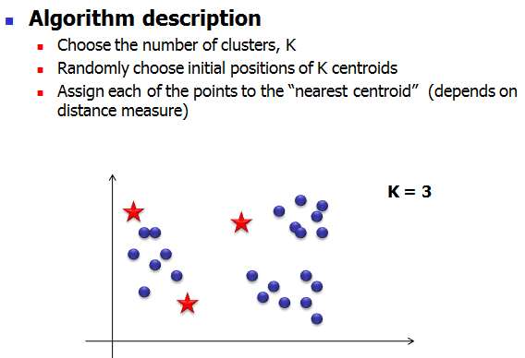
Clustering (k-mean algorithm)

Slide 37
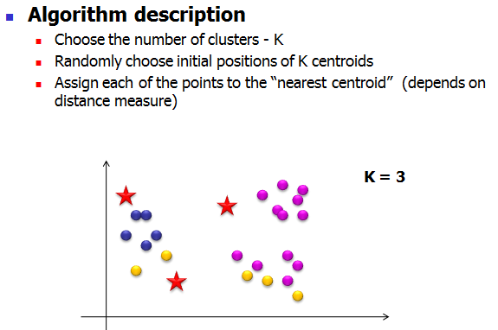
Clustering (k-mean algorithm)

Slide 38
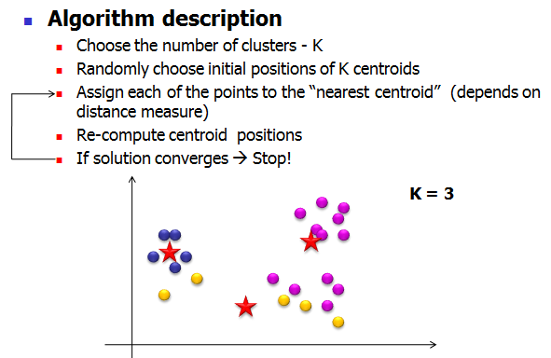
Clustering (k-mean algorithm)

Slide 39
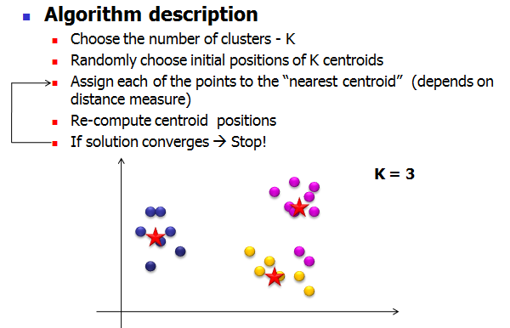
Clustering (k-mean algorithm)

Slide 40
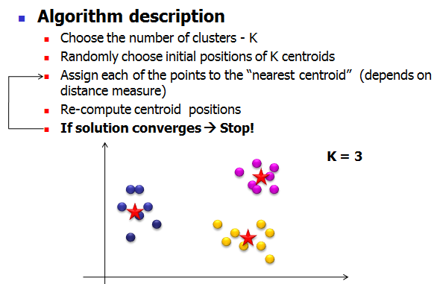
Clustering (k-mean algorithm)

Slide 41
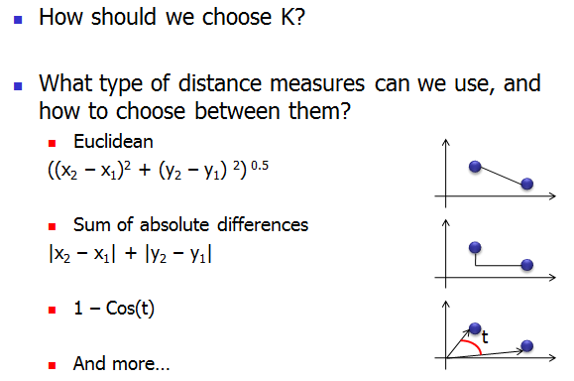
Distance measure for k-mean

Slide 42
Machine Learning
Performance Evaluation

Slide 43
How good is the learning model?
The aim of a model is to be able to produce good results
Employ another set of data called testing data to evaluate the learning model
  Can be completely new
  Blinded dataset from the same resource
  Smaller part of training data previously separated
  Rule of thumb for train-test split (holdout method); 70%:30, 80%:20%, 90%:10%

Slide 44
Performance measures / Evaluation metrics
Confusion matrix to evaluate the performance of ML methods
E.g. of performance measures
  % game won
  % correctly classified images
  % correctly identified text
 |  | Predicted Class
 |  | Yes | No
Actual Class | Yes | True Positive (TP) | False Negative (FN)
 | No | False Positive (FP) | True Negative (TN)

Slide 45
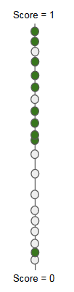
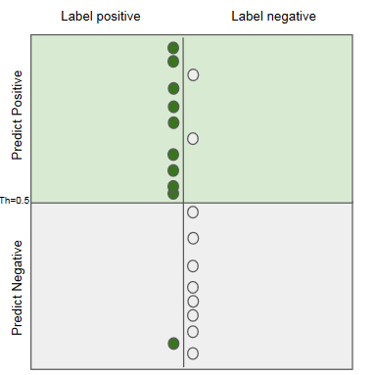
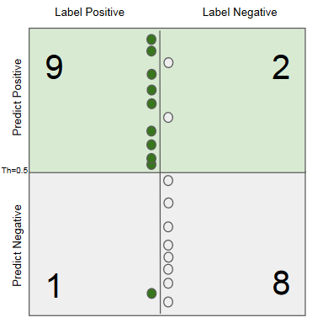
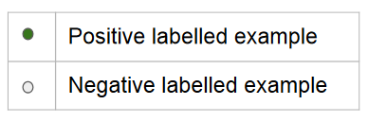
Confusion matrix
Construct

Slide 46
 |  | Predicted Class
 |  | Yes | No
Actual Class | Yes | True Positive (TP) | False Negative (FN)
 | No | False Positive (FP) | True Negative (TN)
TP = 9 (positive observation correctly identified as positive)
TN = 8 (negative observation correctly identified as negative)
FP = 2 (positive that is false i.e. negative observation incorrectly identified as positive)
FN = 1 (negative that is false i.e. positive observation incorrectly identified as negative)

Slide 47
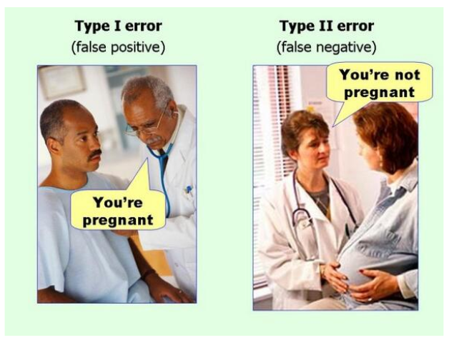
Type I error = FP and Type II error = FN
Lets say positive test result means ‘is pregnant’

Slide 48
Performance measures from confusion matrix
 |  | Predicted Class
 |  | Yes | No
Actual Class | Yes | True Positive (TP) | False Negative (FN)
 | No | False Positive (FP) | True Negative (TN)
Accuracy = TP+TN / (TP+TN+FP+FN) i.e. 1 – error
Precision = TP/(TP+FN)
Recall = TP/(TP+FP)
The closer the score to 1, the better the classifier model
High recall, low precision: This means that most of the positive examples are correctly recognized (low FN) but there are a lot of false positives.
Low recall, high precision: This shows that we miss a lot of positive examples (high FN) but those we predict as positive are indeed positive (low FP)

Slide 49
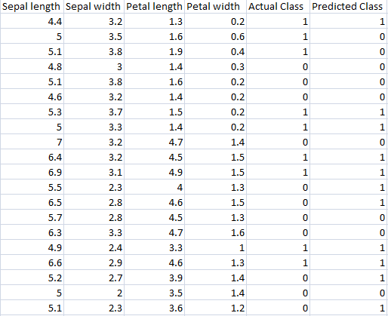
Activity 1: Confusion matrix
Let positive be 1, and negative is 0;
Given the Iris dataset as in the table, quantify TP, TN, FP and FN
Determine the accuracy, precision and recall

Slide 50
Activity 1 Answer: Confusion matrix
 | Predicted: 0 | Predicted: 1
Actual: 0 | 7 | 2
Actual: 1 | 4 | 7
TP=7, TN=7, FN=2, FP=4
Accuracy = TP+TN / (TP+TN+FP+FN)
=7+7/ (7+7+2+4) = 0.7
Precision = TP/(TP+FN) = 7/(7+2)=0.78
Recall = TP/(TP+FP)= 7/(7+4) = 0.64

Slide 51
How real world use ML?
https://towardsdatascience.com/real-world-examples-of-applied-machine-learning-from-ai-conference-4d4678700c6
Real world examples
Uber COTA (Customer Obsession Ticket Assistant)
http://w4nderlu.st/assets/javascript/ViewerJS/#http://w4nderlu.st/content/3-publications/cota-improving-the-speed-and-accuracy-of-customer-support-through-ranking-and-deep-networks/cota-o-reilly-ai-conference-2018.pdf
AirBNB ; categorizing listing photos
https://medium.com/airbnb-engineering/categorizing-listing-photos-at-airbnb-f9483f3ab7e3
ZocDoc ; finding in network physicians from insurance cards
https://www.zocdoc.com/about/blog/tech/making-sense-of-insurance-cards-using-deep-learning/
Spotify ; How does it know your kind of music?
https://medium.com/s/story/spotifys-discover-weekly-how-machine-learning-finds-your-new-music-19a41ab76efe

Slide 52
Computational Intelligence
What methods machines use to learn?

Slide 53
Outline
What is AI?
Now, come Computational Intelligence (CI)
Scope of CI
Importance of CI
CI Techniques
  Artificial Neural Network
  Genetic Algorithm
  Fuzzy Logic

Slide 54
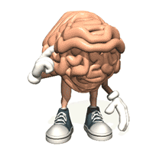
What is AI?
Ability to interact with the real world
Reasoning and Planning
Learning and Adaptation

Slide 55
Now, come Computational Intelligence (CI)
A methodology involving computing that exhibits an ability to learn and/or to deal with new situations, such that the system is perceived to possess one or more attributes of reason, such as generalization, discovery, association and abstraction (Russel et al, 1998).
CI is the field of computing that draws from the successes of natural systems to develop new ways of solving computational problems in the real world.

Slide 56
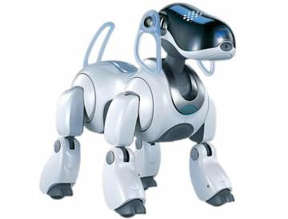
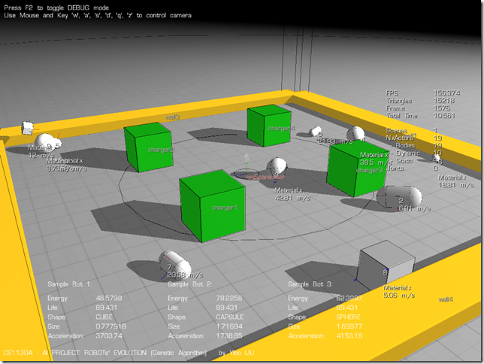
Scope of CI
Practical adaptation concepts, paradigms, algorithms and implementations that enable or facilitate appropriate actions (intelligent behavior) in complex and changing environments.

Slide 57
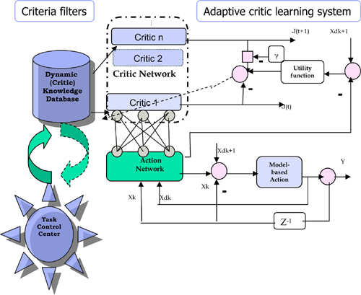
Scope of CI
Fuzzy, imprecise or imperfect data
No available mathematical algorithm
Optimal solution unknown
Rapid prototyping required
Only domain experts available
Robust system required
Learning capability
More recently:
DNA Computing
Quantum Computing

Slide 58
Importance of CI
Solve the problems in realistic situation ( not ideal) such as fuzzy, imperfect or incomplete, only domain experts available.
Complementary approaches with mathematical based algorithm solutions
Encourage new technology development especially in Quantum and DNA computing.

Slide 59
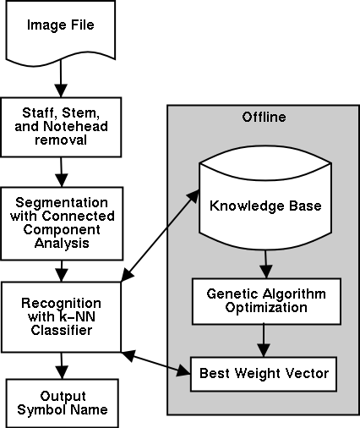
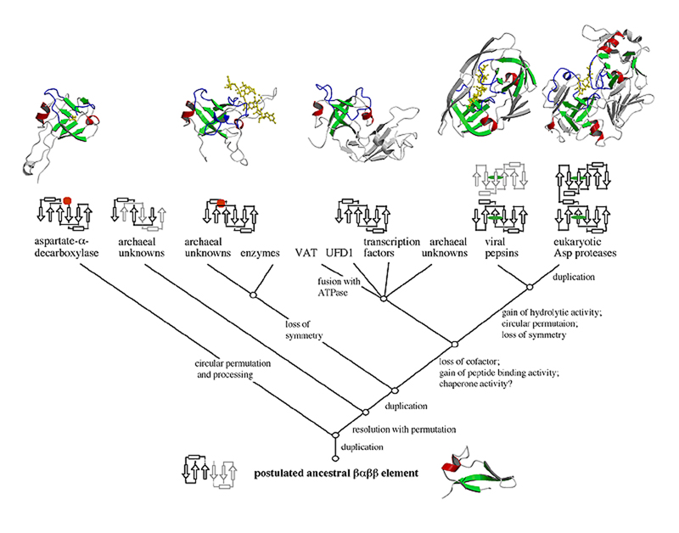
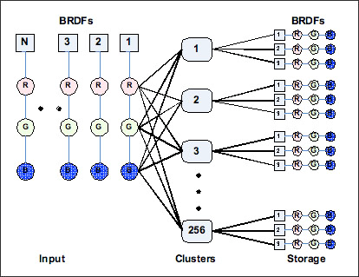
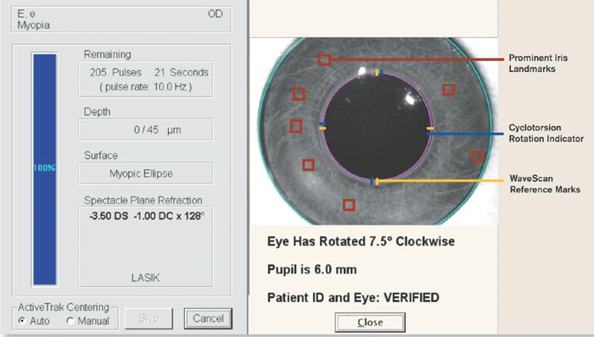
Importance of CI

Slide 60

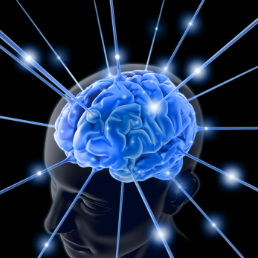
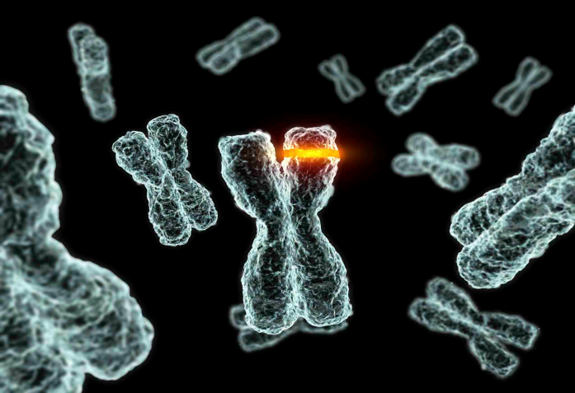
CI Techniques
Artificial Neural Network
Genetic Algorithm
Fuzzy Logic

Slide 61
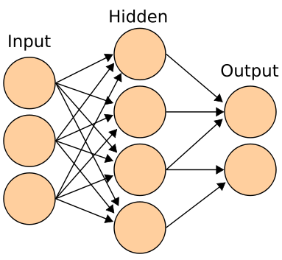
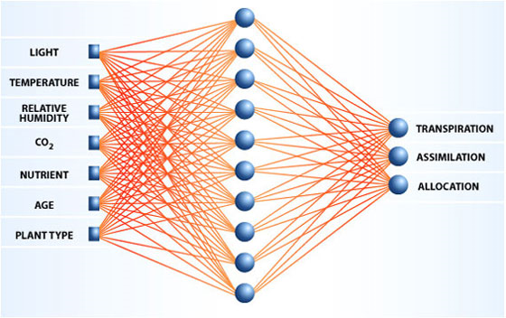
Artificial Neural Network

Slide 62
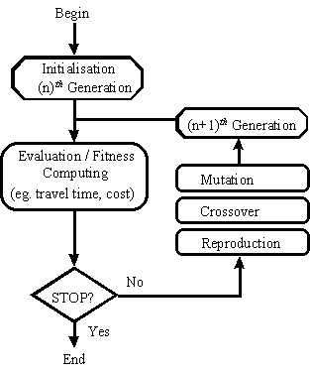
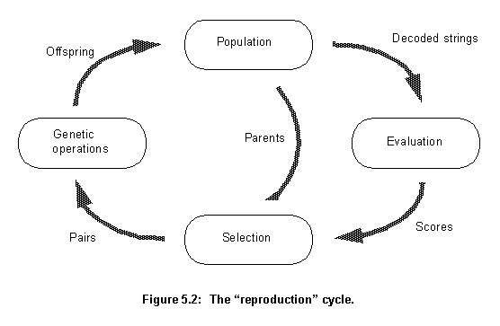

Genetic Algorithm

Slide 63
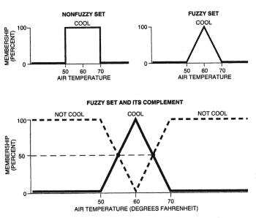
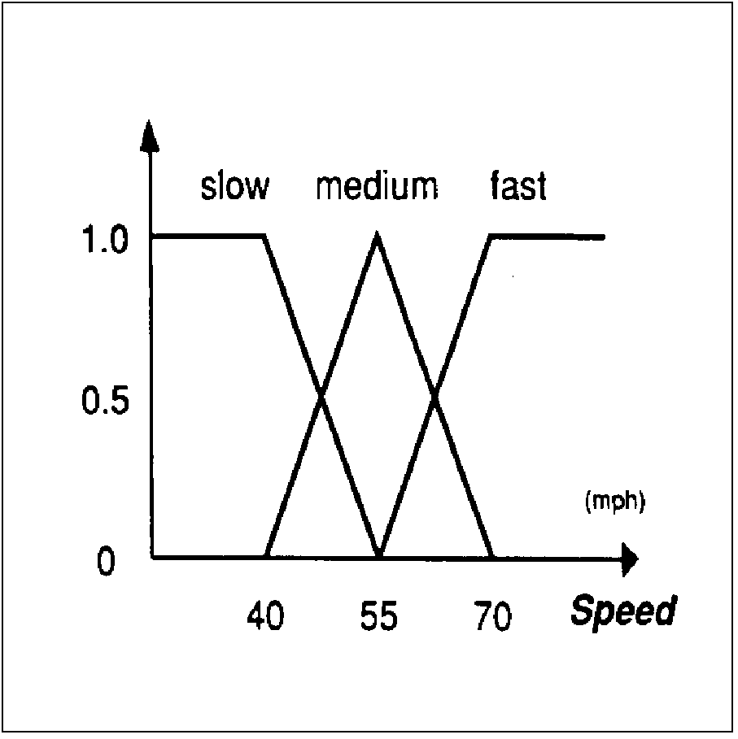
Fuzzy Logic

Slide 64
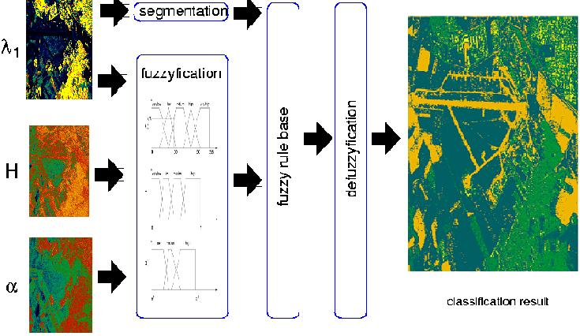
Fuzzy Logic

Slide 65
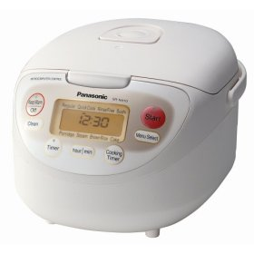
Q & A

